Slide 1
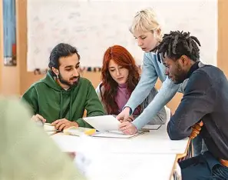
Project Part 1: Kick-Off
Today's class will be devoted to getting started on your team project.
If your instructor has not already done so, you will be divided into teams of 3 or 4 students.
Each team will work together to:
Set up the team repository.
Discuss and design the project.
Plan meeting times.
Practice pair programming.
Start the project!

Slide 2

Project Submissions
This project is organized into three parts with part 1 counting as 2 homework assignments and parts 2 and 3 counting as 1 homework assignment each.
You will have at least 4 days to complete each part.
Each part will be submitted via GitHub, just like regular assignments, except that your team will be working in one repository.
While each project part will receive a grade, your individual grade may be adjusted to be less or more than the team grade. Or it may be left the same as the team grade.
Adjustments to your team grade will be based on your contributions, measured in GitHub metrics, e.g commits, as well as peer evaluations conducted at the end of the project.
Equal contribution is expected from every team member. Dominating the work at the expense of others' participation is just as problematic as not contributing enough
This project is a team effort, and everyone deserves the opportunity to learn and participate.

Slide 3
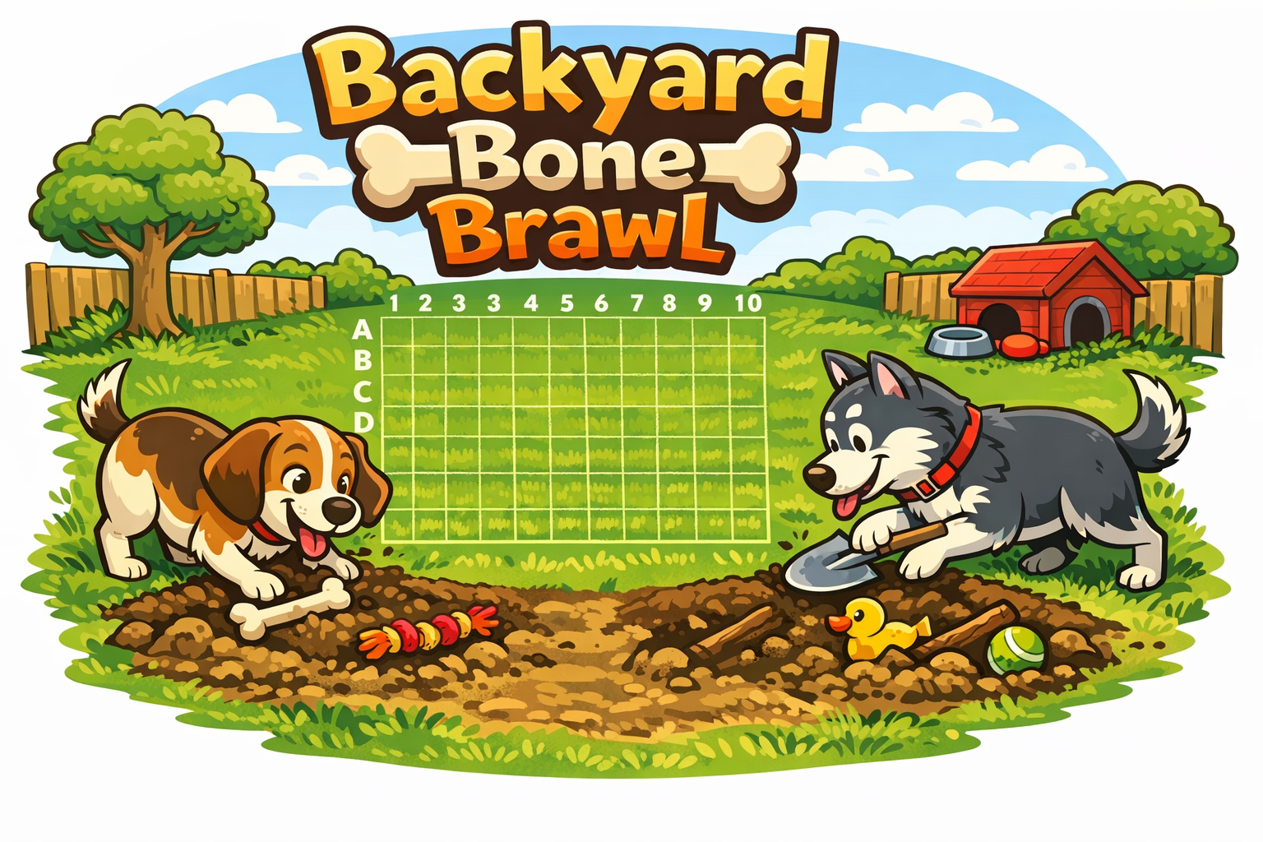
Backyard Bone Brawl
Backyard Bone Brawl Is a turn-based strategy game where two rival dogs compete to dig up each other's buried toys hidden across their backyard.
The game begins with each dog secretly burying five different toys (e.g. stick, bone, squeaky toy, etc) of varying lengths in the backyard - a 10x10 grid. Grid rows are identified with letters and the columns with numbers.
Players take turns digging at a coordinate, e.g. A5, and the defender reports whether the dig resulted in::
A hole (nothing)
A toy part (hit)
The final toy part (toy has been completely uncovered)
The game ends when all five toys belonging to one dog have been found.

Slide 4
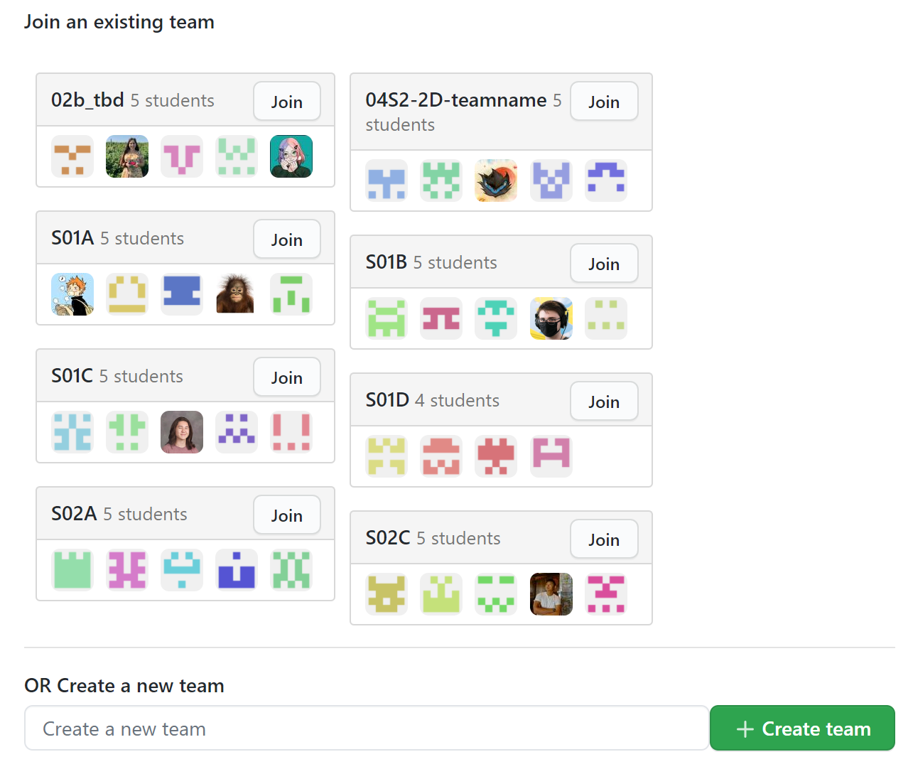
Join the Team
Your instructor will share a GitHub Classroom assignment invitation with you. Unlike the other assignments you have done for this course, the project will require you to create or join a team.
Before proceeding further ask your instructor for guidelines regarding team names.
Select one member of your team to be the first to click on the assignment invitation. GitHub will present that person with the option of creating or joining a new team. This person should create the new team. This will automatically create a new repository with any starter code for the team to use. Be sure to name the team according to your instructor's guidelines!
Only after the team has been successfully created should the remaining team members click the assignment link and join the team.
Do not race each other to click the link! Choose one team member to create the team. Be sure to follow any team naming guidelines provided by your instructor.

Slide 5
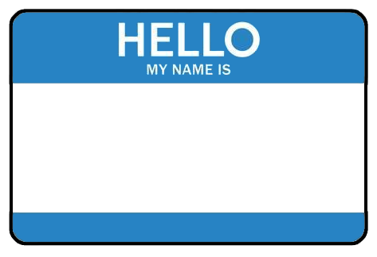
Teamwork
Once everyone on the team has accepted the assignment, you should each clone a copy of the GitHub repository to the computer that you will be using for the rest of today's exercises.
You should then take turns working through the following steps (do not try to do this all at once):
Sit so that you can see each other's screens.
If working remotely, share your screen with your team so that they can see while you work.
Pull the latest version of the repository. If you do not pull first, you may get an error.
Add your name and email to a file named "readme.txt" in the data directory of your repository.
Commit and push the file to the repository.
Repeat until every team member has added their name and email to the repository.
TEAM PLAYER
The purpose of this exercise is to make sure that everyone on the team has access to clone, pull from, and push to the repository.
Please take turns and work so that your team members can see your screen.

Slide 6
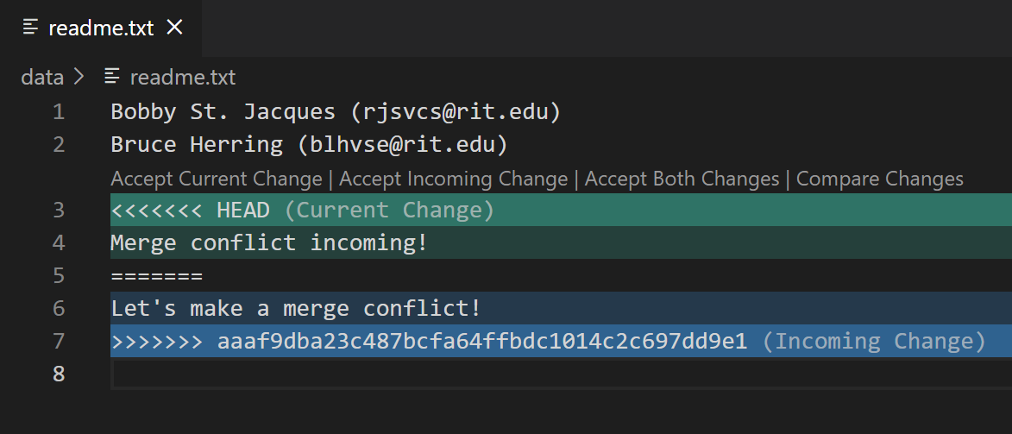
Merge Conflicts
Practice resolving merge conflicts by following these steps:
Make sure that everyone on the team has pulled the latest version of the repository.
Two team members should simultaneously edit the readme.txt file and add a new line to the bottom of the file. It does not matter what the text says as long as each person types something different.
One team member should push their code first. Wait until the push completes.
The second team member should then try to push their changes. The push should be rejected forcing them to pull first.
The pull will cause a merge conflict.
Resolve the conflict by opening the file, scrolling to the conflict (if necessary), and accepting both changes (see left).
Follow the Git workflow to push the merged file to GitHub.
Repeat the above until every member of the team has had a chance to resolve at least one merge conflict.
If a file with a merge conflict is opened in VS Code, it will helpfully highlight the conflict and provide links to fix the problem quickly.
For today, choose the Accept Both Changes option.
In the event that multiple merge conflicts occur (in the same or different files), you will need to resolve them all before you can push your code.

Slide 7
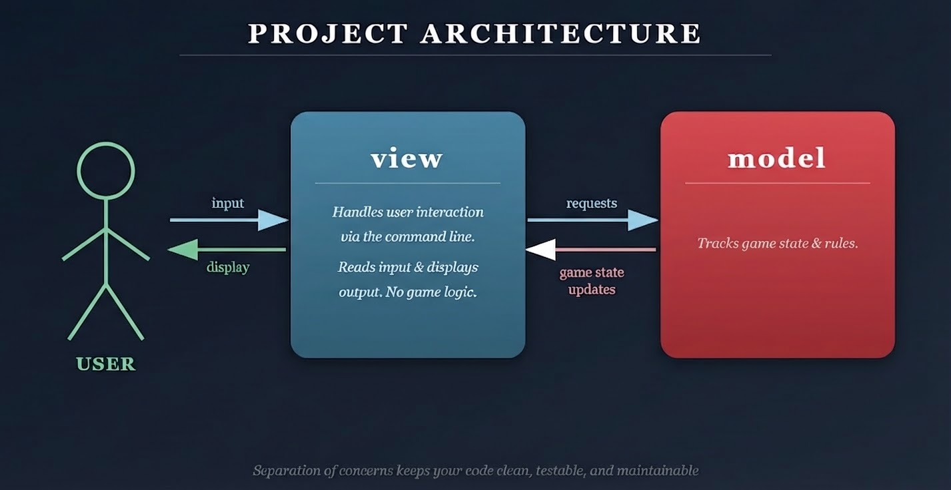
Project Organization
When working on a large project with a team, it is very important to keep your project package structure organized. Doing so not only supports collaboration and maintainability, but will be beneficial in the next parts of the project.
You will notice that your project starter repository includes two packages. Each package has distinct responsibilities:
view - In this package, you will place classes that only deal with user interaction via the Command Line Interface (CLI). This includes reading commands from the user and displaying game information. Be careful not to place any game logic in this package.
model - In this package you will place classes that control the game logic and state. Be careful not to place any direct user interaction code (Scanner, System.out) in this package.
This is known as Separation of Concerns.
Maintaining project organization will make collaboration easier, reduce the likelihood of merge conflicts, and make your code easier to test, debug, and enhance in future parts of the project.

Slide 8
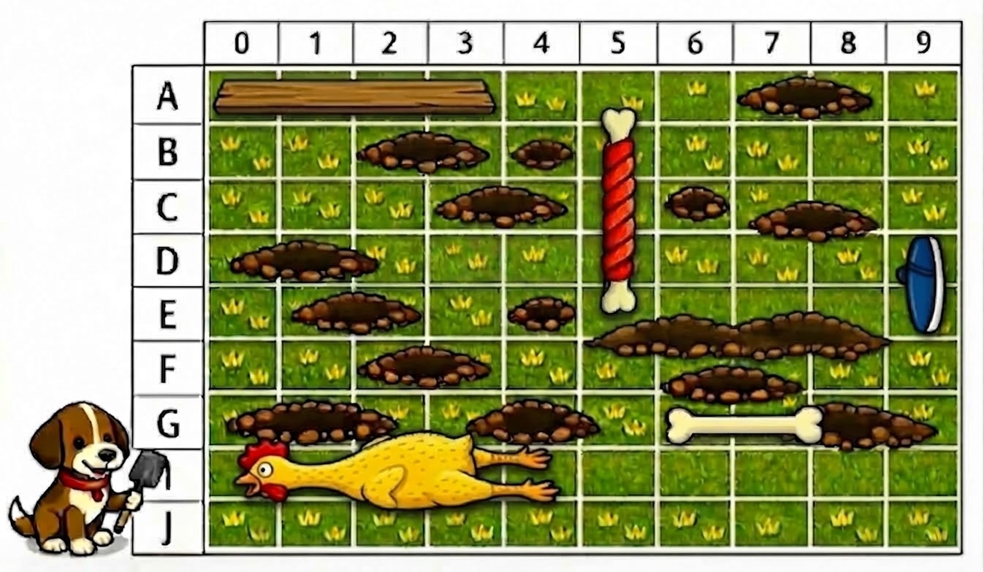
Part 1 Constraints
To ensure the project remains achievable within the timeframe, the implementation will adhere to the following constraints.
The User Interface for Part 1 will be a Command Line Interface (CLI).
The game will be played by a single player, squaring off against a Cyber Pup (computer).
At the start of the game, one of each toy for both the player and the Cyber Pup will be randomly buried in yard coordinates on the grid. Toys may not overlap yard coordinates.
The player will always go first.
Immediately after each dig by the player, the Cyber Pup will automatically take their turn and dig (unless the player has uncovered the final toy part with their dig and hence has won the game).
The grid rows will be lettered 'A' - 'J' and columns will be numbered 0 - 9.
Once the game is over or the player quits, the client should terminate.
While a head-to-head game with players burying their own toys would be more exciting, there is only so many hours in a day.

Slide 9


Pair Programming
Pair programming is a technique during which two developers collaborate to solve a software problem by writing code together.
One developer takes on the role of the driver.
Shares their screen.
Is actively writing code.
The other developer(s) takes on the role of the navigator.
Watches while the driver codes.
Takes notes.
Asks questions.
Points out potential errors.
Makes suggestions for improvements.
The driver and navigator regularly switch roles, e.g. every 10-20 minutes.
Set a timer!
Push your code!
For the rest of today's class as you begin work on your project, you and your team will practice pair programming with one team member acting as the driver and the remaining team members acting as the navigators.
Everyone on the team should take a moment to watch this short video on pair programming.
When you are the driver, you should be using Zoom or Discord to share your screen. Be sure to push your code and switch roles every 10-20 minutes!

Slide 10
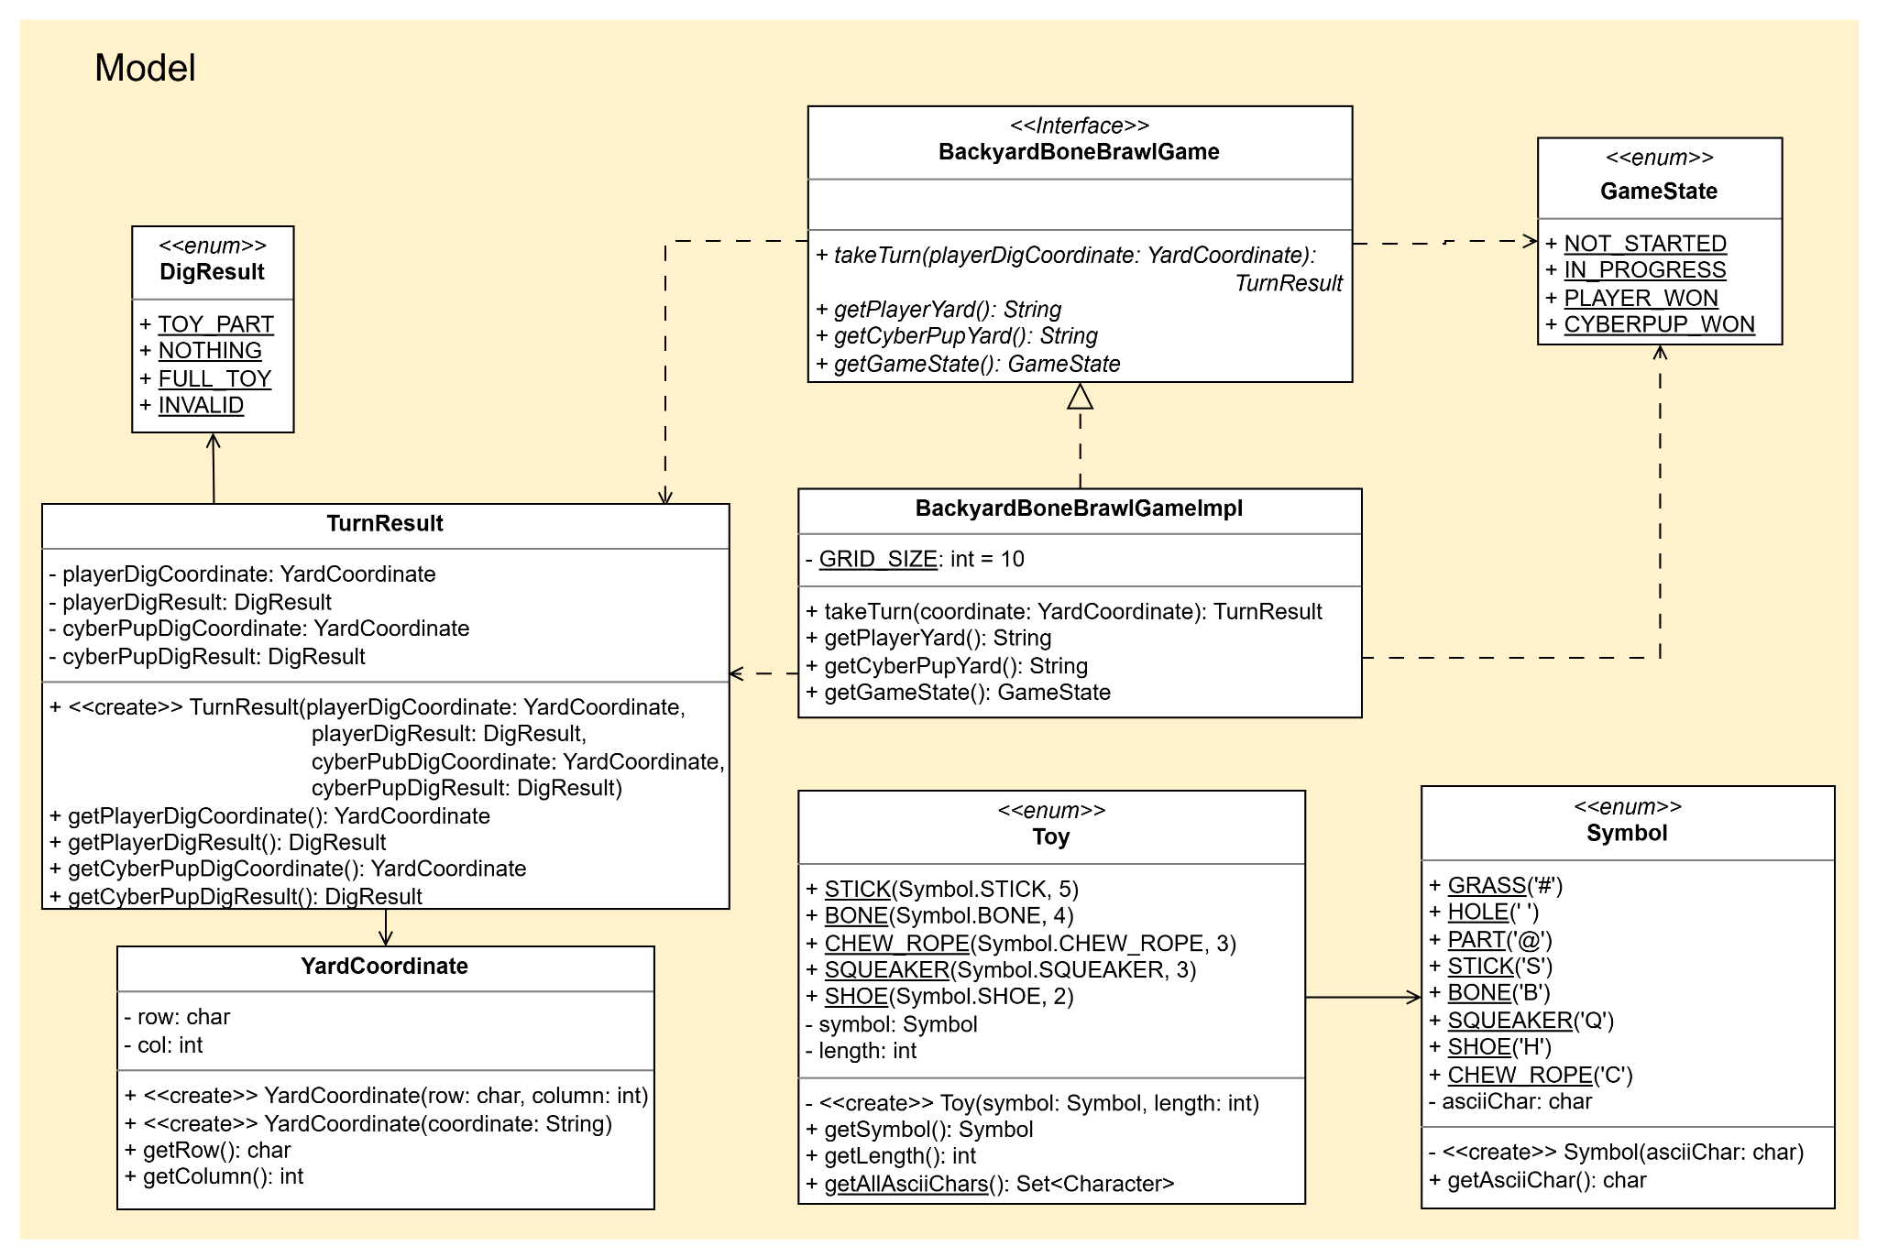
A Partial Design
Refer to this full UML class diagram as needed while you and your team work through the rest of this assignment.

Slide 11
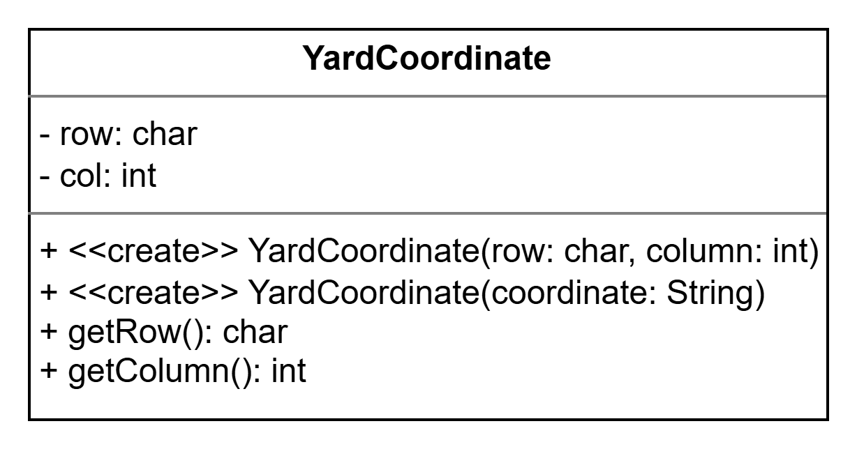
YardCoordinate
The game is driven by coordinates - toys are placed at coordinates and players dig at a location specified by a coordinate.
Recall that each row on the grid is specified by a letter, 'A' - 'J'. Columns will be numbered 0 - 9.
Using the UML to the left, implement the YardCoordinate class enumeration in the bbb.model package.
The YardCoordinate(coordinate: String) constructor is a convenience constructor and can accept a string in the format of "<row><col>", e.g. "A5".
You must include the attributes and methods in the UML. Consider:
Will you need additional attributes?
Will you need additional methods, non-static or static?
Once created, you may remove the delete_me.txt file from the bbb.model package.
While you are required to include the attributes and methods in the diagram above, you may add additional state and behavior if you find it necessary to do so.

Slide 12
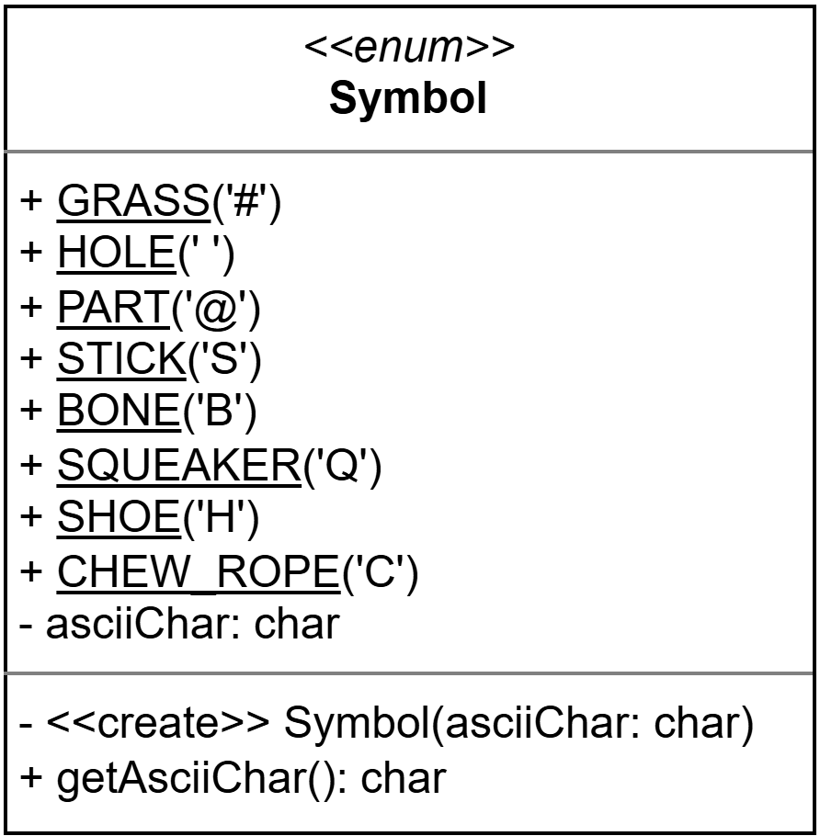
Symbols
Next, you'll need to be able to track and communicate what is happening at each coordinate in the yard.
Has a coordinate been dug yet?
Did it reveal a Toy Part or a Hole?
Using the UML to the left, implement a Symbol enumeration in the bbb.model package.
GRASS - a coordinate that has not been dug at yet.
HOLE - a coordinate that has been dug and contains no toy part.
PART - a coordinate that has been dug and contains a part.
STICK, BONE, SQUEAKER, SHOE, CHEW_ROPE - indicates that a part of the corresponding toy is located at that coordinate. If an opponent digs at this coordinate, the yard will be updated to be a PART symbol.
While you are required to include the values in the diagram above, you may add additional state and behavior if you find it necessary to do so.

Slide 13
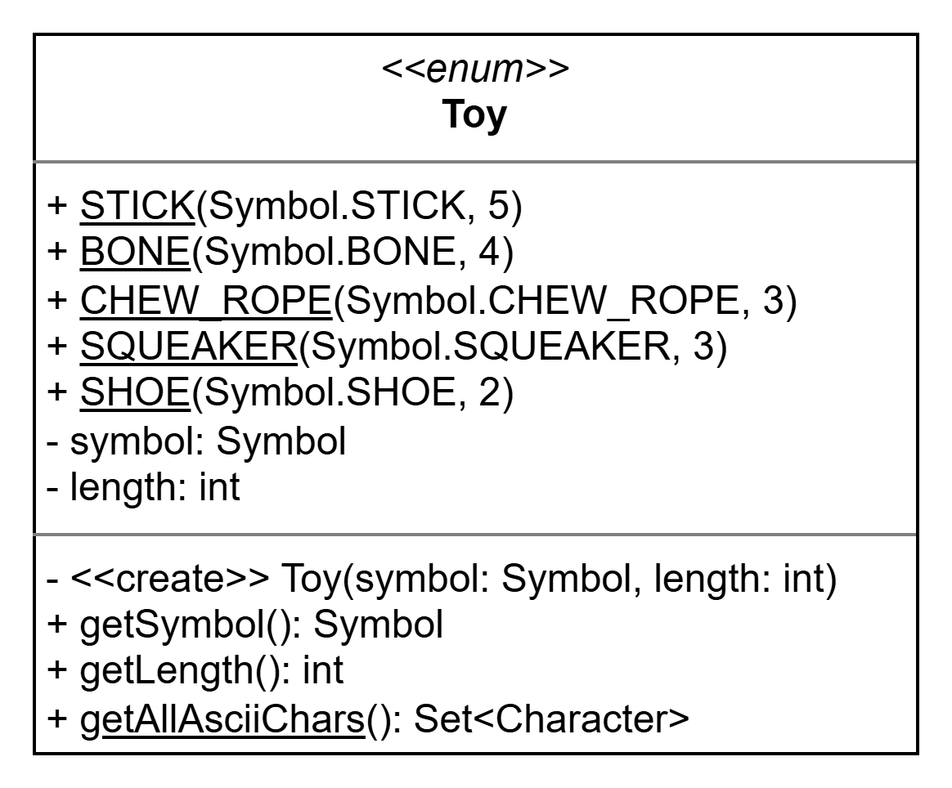
Toys
The game has a variety of toys of varying lengths. Each toy has a Symbol that represents it in the game.
Using the UML to the left, implement a Toy enumeration in the bbb.model package.
You must include the values in the UML. Consider:
Will you need additional attributes associated with each value?
Will you need additional methods, non-static or static?
Will you want to print a nicely formatted version of the enumeration?
While you are required to include the values in the diagram above, you may add additional state and behavior if you find it necessary to do so.

Slide 14
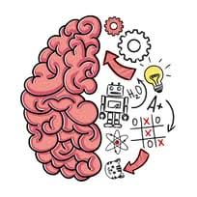
Thinking Logically
Now that you have a good starting point of data structures and attributes, discuss the logic needed to implement the gameplay and maintain the game state.
How will your implementation
Represent the yard and/or grid?
Randomly place the toys?
Determine where the Cyber Pup will dig next?
How will you know if an entire toy has been dug up?
How about if all toys are dug up?
Manage game state?
Return a representation of the yard to the UI?
Take some time to design the yard and/or grid on paper or a whiteboard. You won't regret it.
Once your team feels comfortable with the design decisions made, begin implementing the methods in the UML diagram.
Add attributes and methods as needed.
Resist the urge to zip by design discussions and dive into coding. The further into a project a design flaw is discovered, the more costly it is to fix.

Slide 15
Meeting Times
Date/Time | Location | Area of Focus
3/25 @ 1:00PM | Discord | Yard class
Part 1 of the project counts twice as much as a normal homework assignment. You and your team should plan on spending more time than usual working on it.
You should also plan to work together as much as you can, even if that means setting up a remote meeting using Zoom or Discord.
Plan at least 2 meetings over the course of this part of the project. Each meeting should be at least 1 hour. Following the example on the right, put the information for all scheduled meetings in a meetings.txt file and push to the root directory of your repository.
This part of the project is due Monday, March 30, 2026 at the start of class.
It is highly recommended that you also establish a means of asynchronous communication, e.g. Discord channel, Slack channel, group text, etc, where you can post updates, ask questions, and coordinate.

Slide 16
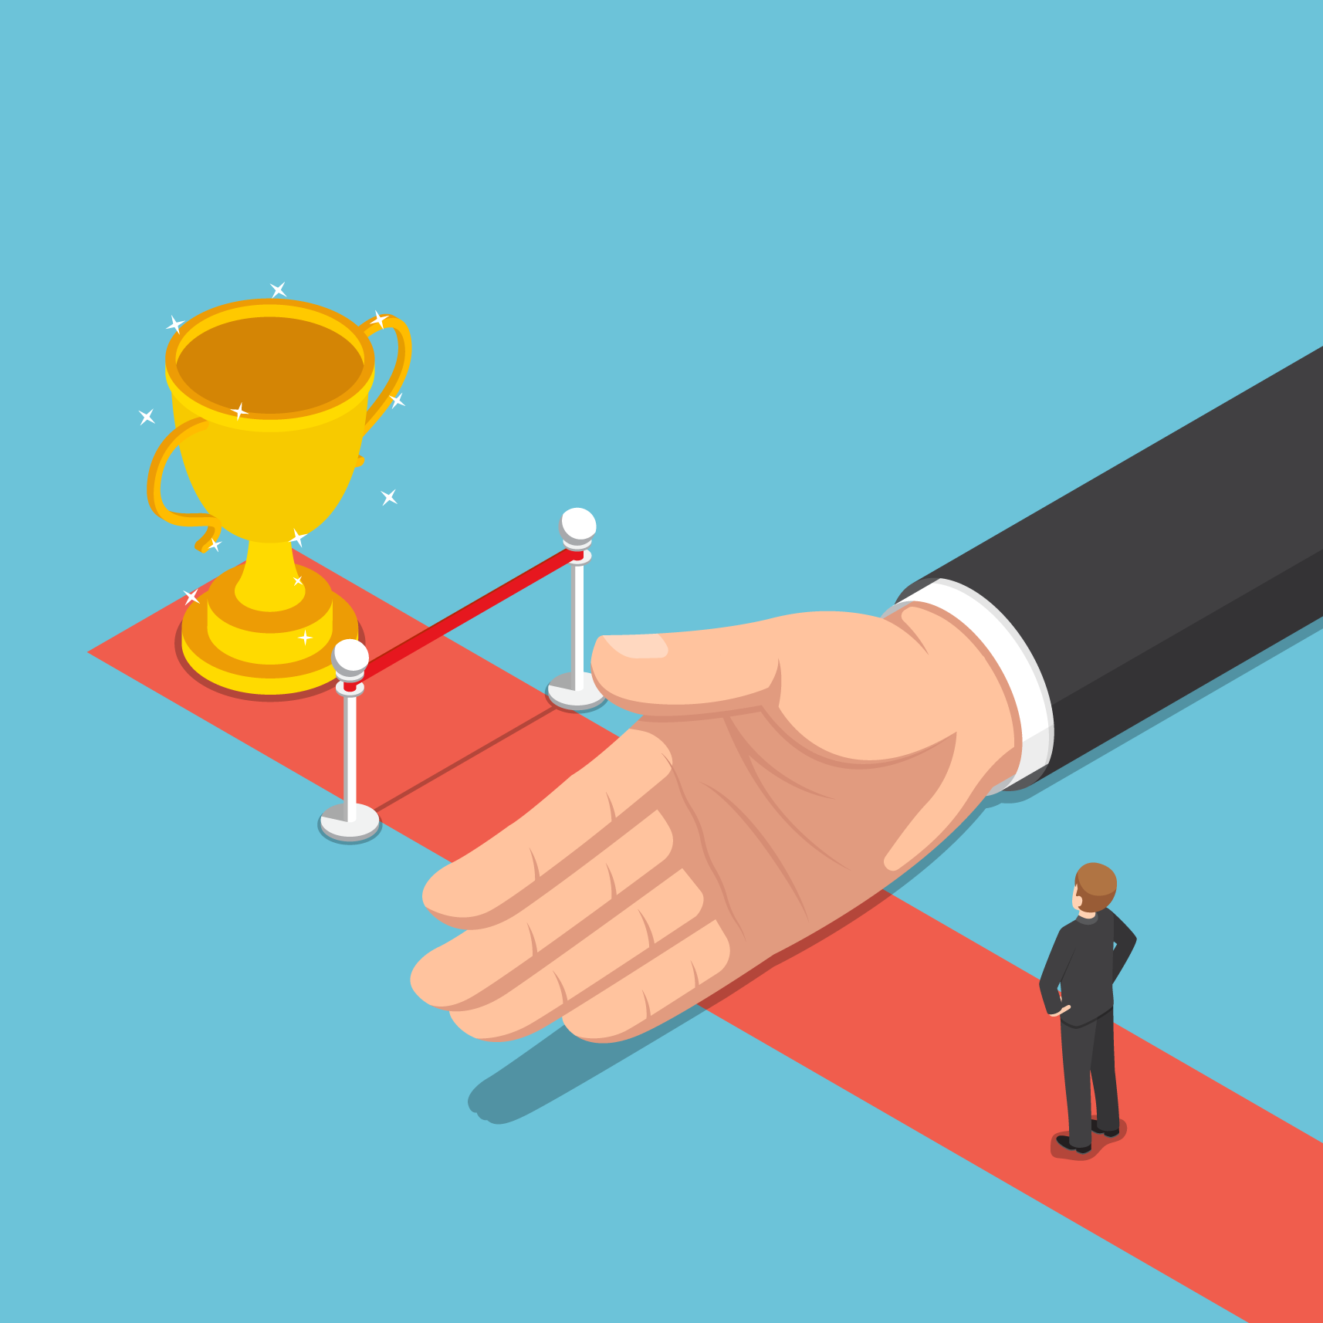
If You Made it This Far...
Your team is off to a good start, but much work on Part 1 of the Project is to be done.
Not quite...
You still need to create a working implementation of Backyard Bone Brawl that can be played by a single user via a command-line interface.
If you have time remaining in class, you should begin reading the full project description, which you will find on MyCourses.

